Slide 1
Agent-based Modeling: Methods and Techniques for Simulating Human Systems
Eric Bonabaun (2002)
Proc. National Academy of Sciences, 99
Presenter: Jie Meng
School of Marketing, UNSW

Slide 2
Outline
Agent-based Modeling (ABM)
Benefits of ABM
Four Application Areas of ABM
Discussion

Slide 3
ABM
A system as a collection of autonomous decision-making entities called agents
Within which, each agent individually assesses its situation and makes decisions on the basis of a set of rules
An aggregate level of result is developed in a bottom-up self-inferring way from individual agents

Slide 4
Why the ABM can apply appropriately to simulate human system?

Slide 5
Benefits of ABM
Capturing Emergent Phenomena
-- A counterintuitive, hard to understand and to predict but dramatic change in aggregate/collective level
e.g., baby gender, traffic jam, voting, “protector game”, global financial crisis
Therefore, AMB can be applied where:
Individual behavior is nonlinear and can be characterized as thresholds, if-then rules, or nonlinear coupling;
Individual behavior exhibits memory, path dependence, and hysteresis, non-markovian behavior, or temporal correlations, including learning and adaption;
Agent interactions are heterogeneous and can generate net-work effects;
Averages will not work

Slide 6
Benefits of ABM
(2) Providing a Natural Description of a System,
because it creates another dimension to interpret a system other than requesting a perspective of horizontal dimension (as a process)
Being closer to the reality when linking micro-macro truth
Being more capable to explain a “non-abstract” fact
Being easy to see the aggregate properties that embedded/implicitly implied by the system

Slide 7
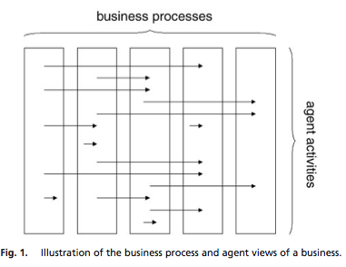
Different Analytical Level —Horizontal VS. Vertical

Slide 8
Therefore, ABM can be used in the situation where:
Individual behavior cannot be clearly defined through aggregate transition rate;
Individual behavior is complex or describing complex individual behavior with equations become intractable;
Activities are a more natural way of describing the system than processes;
Validation and calibration of the model through expert judgment is crucial;
Stochasticity applies to the agents’s behavior.

Slide 9
Benefits of ABM
(3) Being flexible by using different rule-setting
Numbers of agents
Behavior rule
Degree of rationality
Ability to learn and evolve
Rules of interaction
Different observation levels when reporting the simulating outputs (aggregate VS. sub-agent groups VS. single agent)

Slide 10
Four Application Areas in Simulating Human Systems
Flow Simulation
Market Simulation
Organizational Simulation
Diffusion Simulation

Slide 11
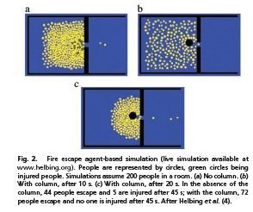
Flow Simulation
Example:
Evacuation Problem
→ Growing population density combined with a better design of transportation or evaluation pattern in a life-threatening situation
(2) Flow Management
→ Traffic Simulation
→ Metropolitan Design
→ Supermarket Pathway Design
→ Department Store’s Layout Design

Slide 12
Market Simulation
Example:
NASDAQ Stock Market’s Decision on Tick Size Reduction (1997)→ Counterintuitive results: reduction of tick size in market level increase the bid-ask spread.
Simulating collective behaviour in the market through individuals who play economic games
Simulating the relation between Internet Service Provider (ISP) and customers

Slide 13
Organizational Simulation
Example:
Operation risk model in financial institutions
Measure the organisational performance and attain a better design by changing organisational parameters and exploring the changes of performance responding to these changes

Slide 14
Diffusion Simulation
→ where there is a need to understand agent’s behaviour in the social context/ network
Example:
Predict whether a movie with big investment will turn out to be a “hit”
Product Adoption Model
Assumption: The value of a new product (V) depends on the numbers of the users (N) in a total population of Nt potential adopters
ρ- the fraction of the population that has adopted the product
Θ-characteristic value, as a “threshold”
d-an exponent that determines the steepness of function
V(N)~[0,1]

Slide 15
If we assume that each person is connected to n other people in the population, we can define person k’s estimate of the fraction of users in the entire population as , where nk is the number of k’s neighbours who have adopted the product.
The value of the product, as estimated by person k, is as:

Slide 16
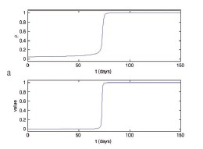
Graphing Result of Simulation
The right graph shows how ρ and V change in time by differentiated equation, (the initial number of users =15% of the population).

Slide 17
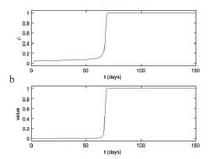
Graphing Result of Simulation
The right graph shows how the fraction of users increases in time for a population of 100 agents by mean-field agent-based model.

Slide 18
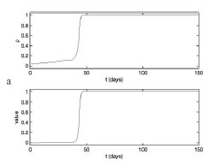
Graphing Result of Simulation
The right graph shows how ρ and V change overtime, with 100 agents and 30 random neighbours

Slide 19
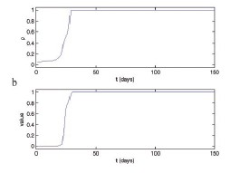
Graphing Result of Simulation
The right graph shows how ρ and V change overtime, with 100 agents while only permitting interactions within neighbour cluster (without long-range interactions)

Slide 20
Discussion
When is ABM useful?
When the interactions between agents are complex, nonlinear, discontinuous, or discrete;
When space is crucial and the agents’ positions are not fixed;
When the population is heterogeneous;
When the typology of the interactions is heterogeneous and complex;
When the agents exhibit complex behaviour, e.g., learning and adaption.

Slide 21
Some issues that are important to ABM
ABM verification & validation
Applicability to human system in terms of some “soft” factors that are difficult to quantify, to calibrate, and to justify, e.g., irrational behaviours, subjective choices and complex psychology
Computation power

Slide 22
THE END
THANKS

